Slide 1


Spotify Data Governance
Data Governance and Strategy

Slide 2
Context
Spotify: world leading audio streaming platform
Manages a vast and complex data ecosystem
user interactions, subscription data, content metadata, ...
Growing needs demand a robust data governance framework

Slide 3
Context
Tasks
Spotify: world leading audio streaming platform
Assess current data maturity of Spotify and identify key challenges
Manages a vast and complex data ecosystem
Propose a data governance plan for Spotify
user interactions, subscription data, content metadata, ...
Propose an implementation for the governance framework
Growing needs demand a robust data governance framework
Present the work to stakeholders

Slide 4
Spotify Data Landscape

Slide 5
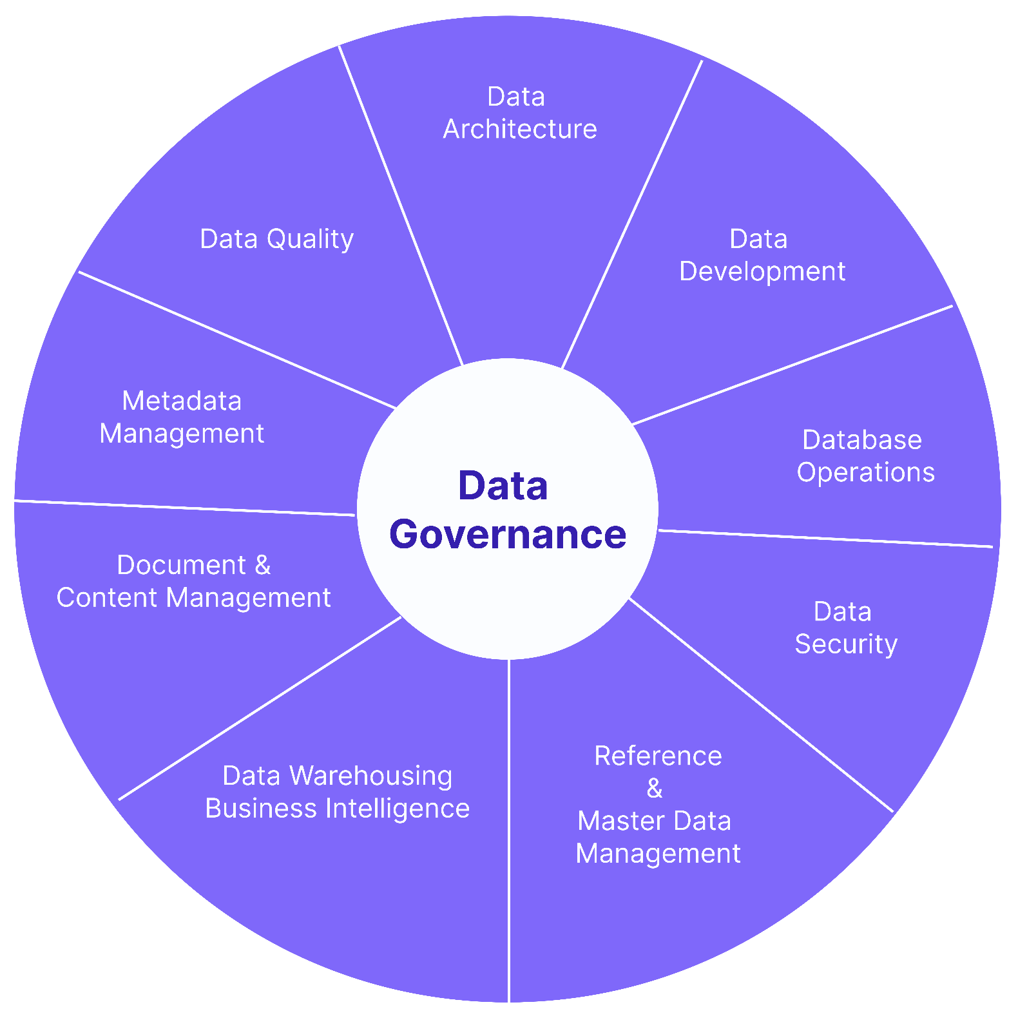
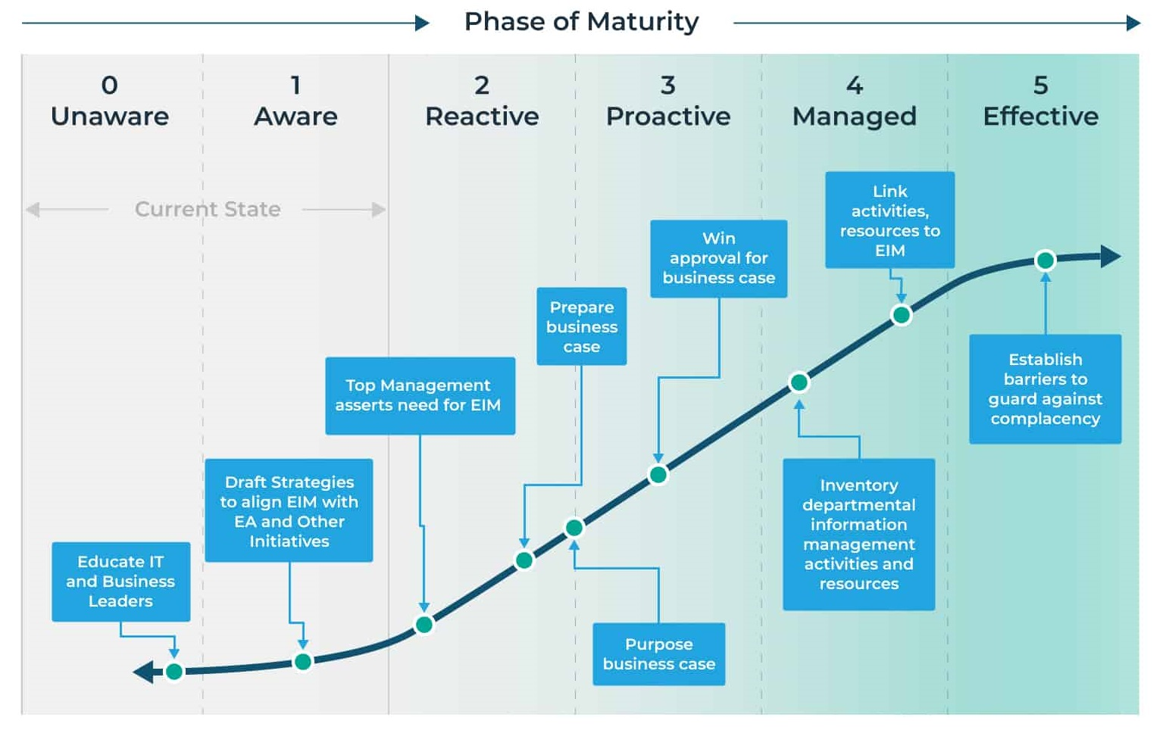
Data maturity assessment
DMBoK data management framework
Gartner data maturity scale

Slide 6
Data maturity assessment
Gartner data maturity scale
Overall maturity level :
Reactive to Managed (2 - 4)
Strengths
Need to unify data governance across all departments
Strong infrastructure and analytics
Uneven governance practices
Advanced real-time data infrastructure
Robust analytics and ML for personalization
High data volume handling

Slide 7
Key Challenges
Data silos and fragmentation
Access and integration barriers
Legacy data handling by independent departments. Needs a unified data view.
Disconnected systems slow down data access. Need a unified data integration strategy.
Regulatory compliance complexity
User privacy and trust
Navigate in rapidly evolving regulations across 180+ countries. Need dynamic strategy and stronger ovesight.
Increased user awareness of data rights. Requires better consent management and anonymization protocols..
Low metadata quality
Weak data culture
Metadata inconsistently applied to various products (e.g. podcast and songs). Impacts systems such as recommendation engines.
Limited and non-unified data literacy and governance awareness.

Slide 8
Data Governance Framework

Slide 9
Data Governance Principles
Accountability
Compliance
Assign clear data ownership and stewardship across teams.
Ensure compliance with regulations (GDPR, CCPA, etc).
Transparency
Ethical Use
Data usage by Spotify must be clear to users.
Commit to responsible and privacy-centered data use.
Data Security
Protect sensitive data, safeguard against breaches.
User Rights
Data Quality
Provide tools allowing for a fine-grained control of their data by users.
Ensure data accuracy, consistency and completeness.
Continuous Improvement
Data Minimization
Regularly review and adapt governance practices.
Collect and retain only necessary data.

Slide 10
Regulatory Compliance
Requirement | Regulation | Implementation
Data processing principles | GDPR | Transparent, user-friendly notices in every market
User Rights and Consent Management | GDPR/CCPA | Portal for access, deletion, and correction requests ; consent banners, opt-in/opt-out options for cookies and analytics
Data Breach Notification | GDPR | Incident response procedure and breach dashboard overseen by DPO
Secure and Monitor Network & Systems | PCI-DSS | Implement security measures such as firewalls ; assess security through pentesting, ensure proper logging
Protect and Control Access to Data | PCI-DSS | Setup encryption and secure storage ; define access rules for the different data domains and limit access authorized personnel
Vulnerability Management Program | PCI-DSS | Perform regular security audits, ensure systems are up-to-date
Information Security Policy | PCI-DSS | Create and maintain a definite information security policy, ensure regular training of the teams

Slide 11
Roles and Responsibilities
Role | Key responsibilities
Chief Data Officer (CDO) | Leads data governance strategy, policy and KPIs
Data Protection Officer (DPO) | Ensures compliance with regulations (GDPR, CCPA, etc), handles breaches, data subject access requests (DSARs)
Head of Engineering | Builds systems to support secure, governed data access
Marketing Director | Uses the data to drive marketing campaigns or get insight about the platform usage
Data Stewards | Manage data definitions, quality, access control, and metadata within domains
Legal Counsel | Advises on compliance risks and regulatory interpretation
Product & Marketing Leads | Ensure responsible use of user data and accurate analytics

Slide 12
Data Governance Framework Implementation

Slide 13
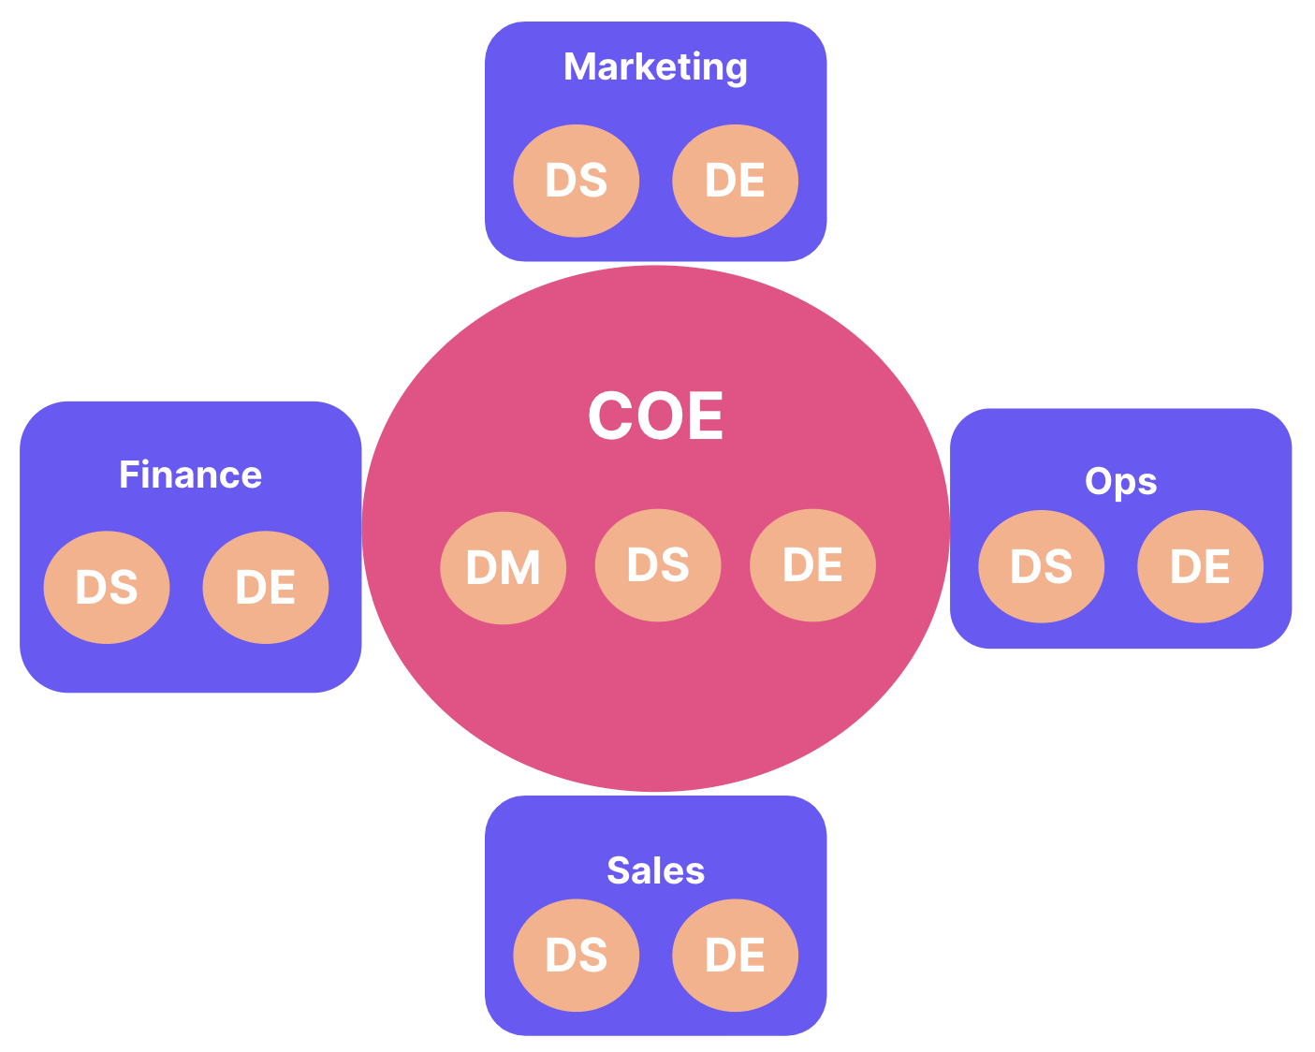
Organizational Model
Center of Excellence (CoE) Model
Central data governance team
- Lead by Chief Data Officer
- Defines standard and practices for data management
- Provides training and support to data teams
Cross-functional governance committee
- DPO, legal counsel, business leaders, etc
- Oversights data management and compliance
- Adjust governance to the needs of the company
Embedded data teams
- In each department (finance, marketing, etc)

Slide 14
Technologies and Tools
Category | Purpose | Examples
Data cataloging | Central metadata management, data discovery | Alation, Apache Atlas, Atlan, Collibra
Data quality | Automate data profiling, validation, alerts | Ataccama, Informatica Data Quality, Soda, Talend
Compliance monitoring | Manage user consent, automate DSARs | BigID, OneTrust, TrustArc, VeraSafe
Data security | Protection of sensitive user and payment data | DataGuard, Splunk, Vormetric
Lineage and integration | Track data flow across systems | Apache Atlas, Informatica

Slide 15
Pilot Implementation : Overview
Objective
Test the effectiveness of the proposed Data Governance Framework using the User data domain : personal info and interactions with the platform

Slide 16
Pilot Implementation : Overview
Objective
Test the effectiveness of the proposed Data Governance Framework using the User data domain : personal info and interactions with the platform
Why the user data?
Critical to key components of the governance framework : compliance, quality and security

Slide 17
Pilot Implementation : Overview
Objective
Test the effectiveness of the proposed Data Governance Framework using the User data domain : personal info and interactions with the platform
Why the user data?
Critical to key components of the governance framework : compliance, quality and security
Key Goals
Improve data quality (accuracy, completeness, consistency)
Ensure compliance with GDPR/CCPA for user data
Streamline access to clean data for authorized staff
Mitigate risks associated with data misuse or poor quality

Slide 18
Pilot Implementation : Timeline & Risks
Timeline
Highlights
Milestone | Target date | Responsible
Kickoff meeting | asap | Project Manager
Data assessment and cleansing | + 1 month | Data Steward
GDPR/CCPA compliance audit | + 1 month | DPO
Technical setup and integration | + 2 months | IT Engineer
Mid-project review | + 2 months | Project Manager
Final review and closure | + 4 months | Project Manager

Slide 19
Pilot Implementation : Timeline & Risks
Timeline
Highlights
Risks and
Mitigations
Milestone | Target date | Responsible
Kickoff meeting | asap | Project Manager
Data assessment and cleansing | + 1 month | Data Steward
GDPR/CCPA compliance audit | + 1 month | DPO
Technical setup and integration | + 2 months | IT Engineer
Mid-project review | + 2 months | Project Manager
Final review and closure | + 4 months | Project Manager
Risk | Mitigation Strategy
Non-compliance with regulations | Weekly audits and DPO signoff
Team resistance to new processes | Workshops and clear benefits framing
Unresolved data quality issues | Documentation, regular monitoring and review
Technical integration complexity | IT involvement in early scoping

Slide 20
Pilot Implementation : KPIs & Deliverables
Key Performance Indicators (KPIs) : compliance, quality, performance
90 % service-level agreement compliance on data subject requests
0 security incidents involving personal data during the pilot
10 % reduction in missing or inaccurate user interaction logs
< 3 % data quality error rate in user data domain
20 % improvement in data access time

Slide 21
Pilot Implementation : KPIs & Deliverables
Key Performance Indicators (KPIs) : compliance, quality, performance
Expected deliverables
90 % service-level agreement compliance on data subject requests
0 security incidents involving personal data during the pilot
10 % reduction in missing or inaccurate user interaction logs
< 3 % data quality error rate in user data domain
20 % improvement in data access time
Data quality report (metrics for missing/duplicate/inconsistent data)
Compliance assessment report (GDPR/CCPA compliance of data processing practices)
Technical integration plan (data availability across the department)
Risk assessment report (data security and exposure, mitigatoin strategies)
Stakeholder feedback summary (effectiveness of the framework)

Slide 22
Pilot Implementation : Next steps
Scaling plan for the whole data infrastructure
Adjustments based on the pilot outcomes
Refined strategy and timeline for the implementation

Slide 23

Thanks!

